Slide 1
News Evaluate
Nachiket, Preetham Thelluri Hakan Gunerli, Alero Adegoroye

Slide 2
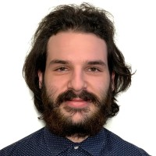
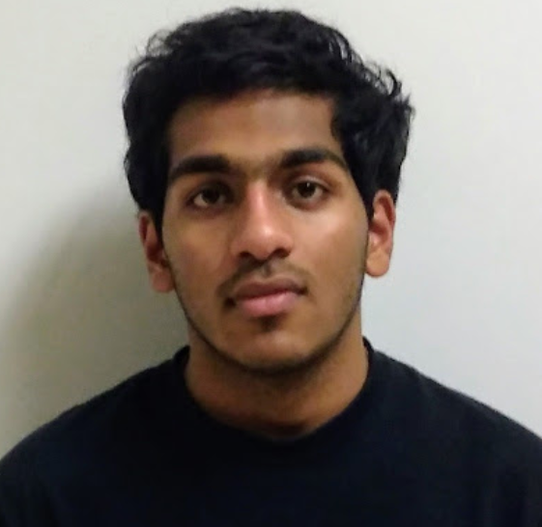
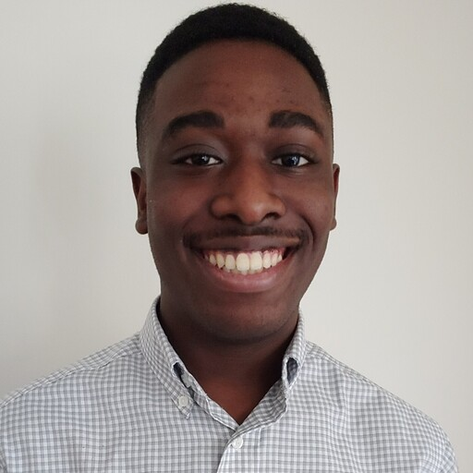
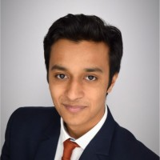
Members
Hakan Gunerli
Preetham Thelluri
Alero Adegoroye
Nachiket Hinge

Slide 3
Problem Statement
There is a lack of readership in news article!
More people choose to skim over the articles instead of reading the full article
A lot of people also try to avoid reading negative articles
Notes:
Although the city has done a lot to reduce crime in the recent years, we believe the importance to educate ourselves and others by informing to be the best way to further reduce the rates.

Slide 4
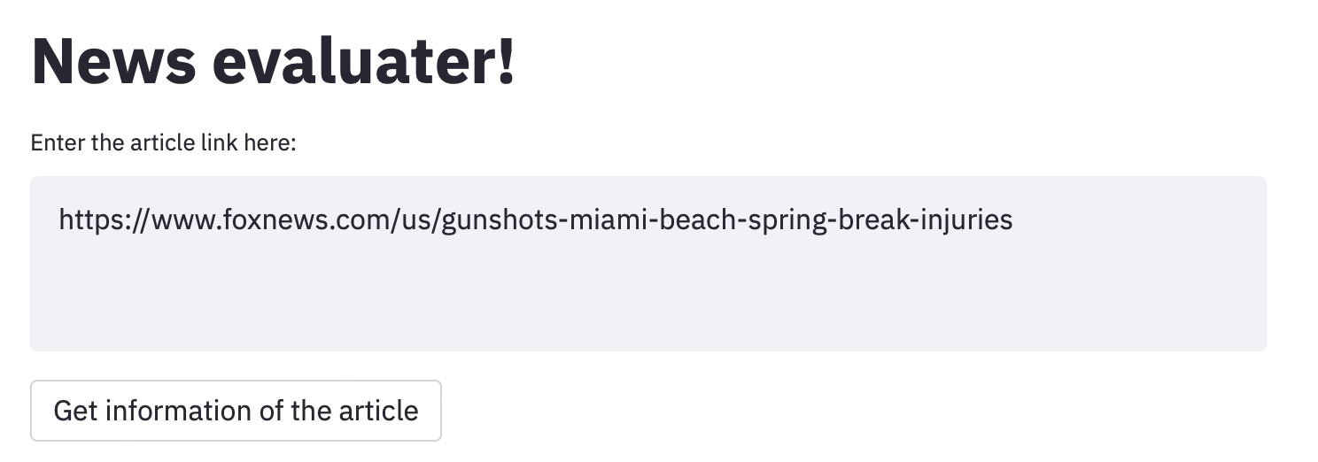
How do we tackle this problem?
A state of the art news evaluation!

Slide 5
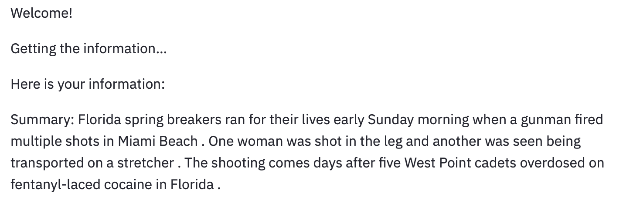
How’s our product special?
Our product summarizes the article with great accuracy

Slide 6
How’s our product special?
Our product also classifies the article as positive or negative

Slide 7
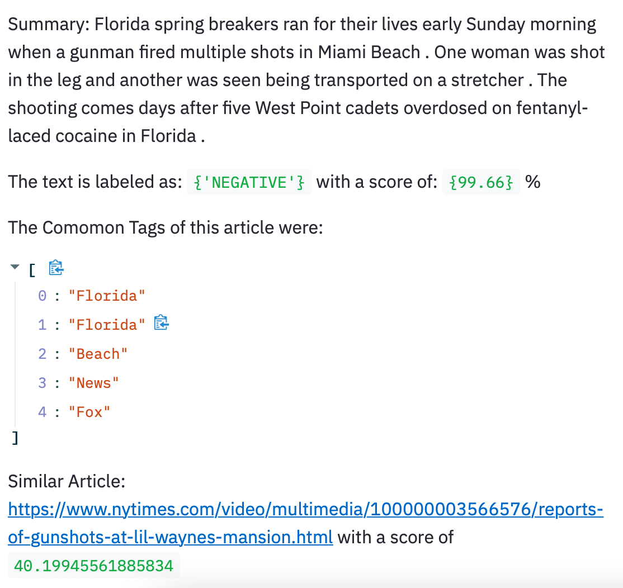
Optimized for on the go!
Using the advantages of responsive design, and the flexibility of Streamlit, the information can be also accessed using the streamlit package.

Slide 8
Demo
Notes:
https://www.foxnews.com/us/gunshots-miami-beach-spring-break-injuries

Slide 9
Thank you
Don’t forget, there’s no time for crime!

